Slide 1

Effects of Supersaturation of Calcium Carbonate on Hairy Shore Crab (Hemigrapsus oregonensis)
Research Question: How will dissolved calcium carbonate affect Hairy Shore Crab (Hemigrapsus oregonesis)?
Hypothesis (Calcium Carbonate): Excess dissolved calcium carbonate in the water will bind to both their shells and to their gills internally, reducing righting times and ability to respire
Null Hypothesis (Calcium Carbonate): Excess calcium carbonate will have no effect on the crabs
Hypothesis (Temperature): Increased temperature stress will further exacerbate the the effects of the calcium carbonate and lead to longer righting times and higher mortality rates
Null Hypothesis (Temperature): Temperature will have no effect on the physiological impacts of the calcium carbonate
.
Four groups of five crabs were placed in four different environments: one in cold water with no CaCO₃, one in cold water with CaCO₃, one in warm water with no CaCO₃, and lastly one in warm water with CaCO₃

Slide 2
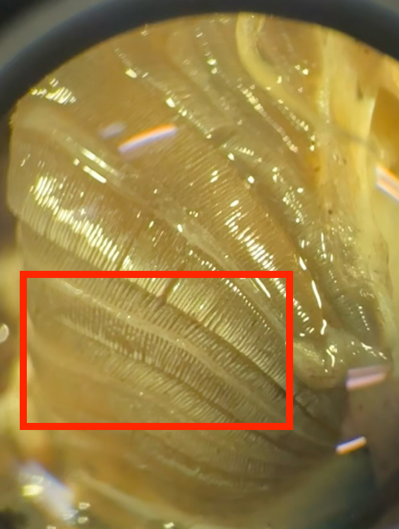
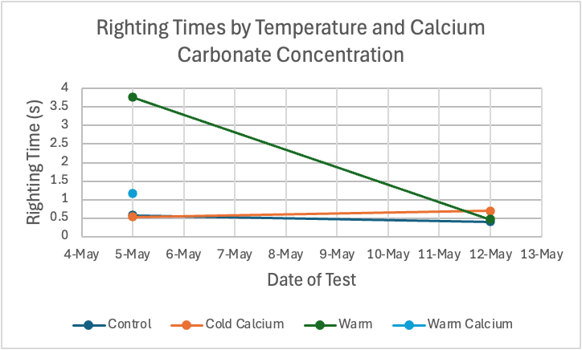
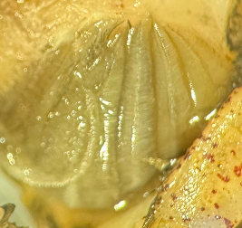
Results
Proposed analysis
Qualitative profile of gill condition by treatment
Changes in hemolymph lactate and BAC protein levels by treatment
Changes in righting time by treatment

